Slide 1

INSTITUTE ENGINEERING
DEPARTMENT ACADEMIC UNIT-1
Bachelor of Engineering (Computer Science & Engineering)
Subject Name Basics Electrical & Electronics Engineering
Subject Code 21ELH-101
By
Akhil Nigam
Unit-1 Chapter-1
Introduction to Kirchhoff’s Law
DISCOVER . LEARN . EMPOWER

Slide 2
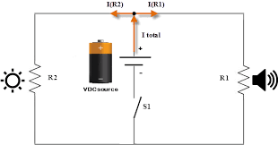
Lecture Objectives
S. No. | Objectives
1 | To make student aware about introduction to kirchhoff’s law.
2 | To aware about different terms used in kirchhoff’s law
3 | To provide knowledge kirchhoff’s current law with examples.
4 | To provide knowledge kirchhoff’s voltage law with examples.
5 | To give applications of kirchhoff’s law.
https://library.automationdirect.com/basic-electrical-theory/

Slide 3
Course Objectives
S. No. | Objectives
1 | To meet students with basic knowledge of dc circuits, electromagnetism and ac fundamentals.
2 | To aware about introduction to single and three phase ac circuit with their construction and working principles.
3 | To provide knowledge about electrical and electronics engineering fundamentals.
4 | To acquire specific knowledge skills so as to comprehend how electric, magnetic and electronic circuits are applied in practice.
https://library.automationdirect.com/basic-electrical-theory/

Slide 4
Course Outcomes
CO Number | Title | Level
CO1 | Identify the different types of electrical elements and the basic op-amp circuit elements and to illustrate the various types of motors, transducers and batteries. | Remember
CO2 | Understand basic principles of transformers, transducers, op-amps, DC and AC motors and to compare the different methods for analyzing electrical and magnetic circuits. | Understand
CO3 | Derive the relationships between parameters in electric and magnetic circuits and motors and to determine specifications of op-amps. | Analyze
CO4 | Solve the basic problems related to electric circuits, magnetic circuits and motors and to assess the characteristics of different configurations of op-amps. | Evaluate
CO5 | Design the different applications of transducers, motors as well as the op-amps like adders, subtractor and comparators. | Create
https://library.automationdirect.com/basic-electrical-theory/

Slide 5
Importance of Basic Electrical & Electronics Engineering
Use from home appliances to industrial plants.
Usage in communication and satellite navigation system.
Handles in electronics equipment and computers.
Deals with the problem of power transmission and motor control.
Control and monitor the medical appliances in hospitals.
High voltage applications with heavy current.
Robotics applications.
Product designing and development.

Slide 6
Content
Introduction to Kirchhoff’s law
Different terms used in Kirchhoff’s law
Kirchhoff’s current law
Example based on KCL
Kirchhoff’s voltage law
Example based on KVL
Difference between KVL & KCL
Applications of Kirchhoff’s Laws

Slide 7
Kirchhoff’ Laws
In 1845, a German physicist, Gustav Kirchhoff developed a pair of laws that deal with the conservation of current and energy within electrical circuits.
These two laws are commonly known as Kirchhoff’s Voltage Law and Kirchhoff’s Current Law.
These laws help in calculating the electrical resistance of a complex network or impedance in case of AC and the current flow in different streams of the network.

Slide 8
Terms Used in Kirchhoff’ Laws
Node: A node is a point in the network or circuit where two or more circuit elements are joined.
Junction: junction is a point in the network where three or more circuit elements are joined. It is a point where the current is divided.
Branch: The part of a network, which lies between the two junction points is called a Branch.
Loop: A closed path of a network is called a loop.
Mesh: The most elementary form of a loop which cannot be further divided is called a mesh.

Slide 9
Kirchhoff’ Current Law
Kirchhoff’s Current Law goes by several names as Kirchhoff’s First Law and Kirchhoff’s Junction Rule.
According to the Junction rule, in a circuit, the total of the currents in a junction is equal to the sum of currents outside the junction.
While applying the KCL the incoming current is taken as positive and the outgoing current is taken as negative.
It determines the current flowing through each branch of the network.

Slide 10
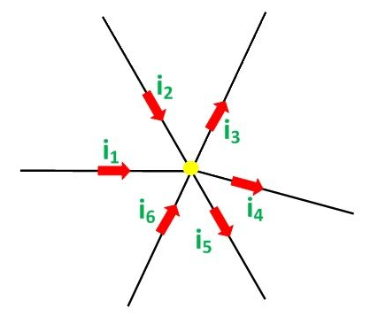
Kirchhoff’ Current Law
Kirchhoff’s Current Law states that” the algebraic sum of all the currents at any node point or a junction of a circuit is zero”.
Σ I = 0
Fig. 1 kcl
https://circuitglobe.com/what-is-kirchhoffs-current-law-and-kirchhoffs-voltage-law.html

Slide 11
Kirchhoff’ Current Law
Considering the above figure as per the Kirchhoff’s Current Law:
i₁ + i₂ – i₃ – i₄ – i₅ + i₆ = 0……….(1)
The direction of incoming currents to a node is taken as positive while the outgoing currents are taken as negative.
The reverse of this can also be taken, i.e. incoming current as negative or outgoing as positive. It depends upon your choice.
The equation (1) can also be written as:
i₁ + i₂ + i₆ = i₃ + i₄ + i₅
Hence Sum of incoming currents = Sum of outgoing currents

Slide 12
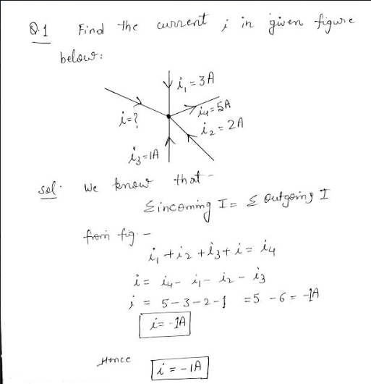
Numerical Based on Kirchhoff’ Current Law
Fig. 2 Example on KCL

Slide 13
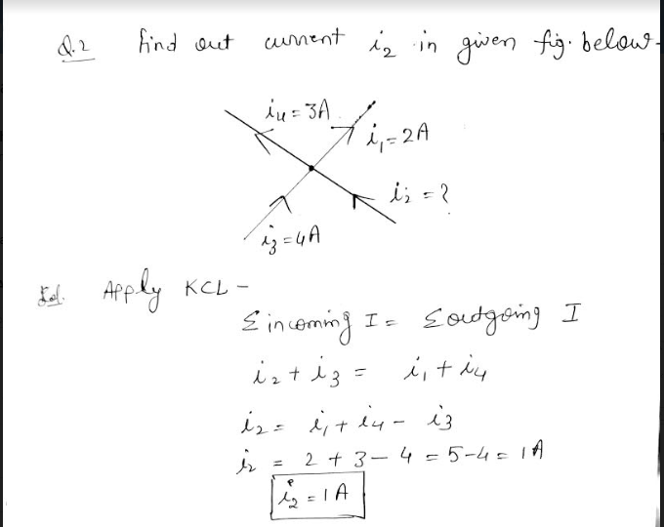
Numerical Based on Kirchhoff’ Current Law
Fig. 3 Example on KCL

Slide 14
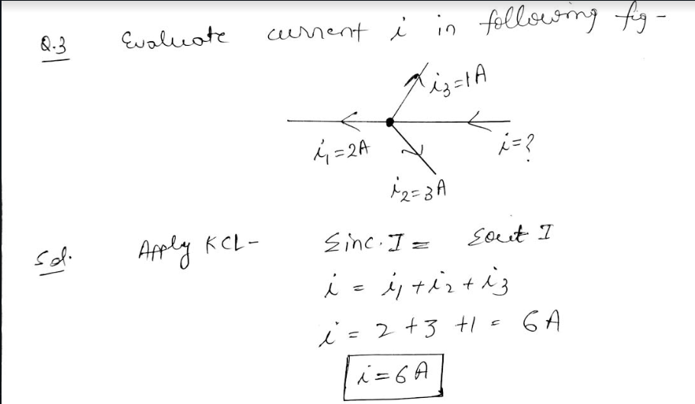
Numerical Based on Kirchhoff’ Current Law
Fig.4 Example on KCL

Slide 15
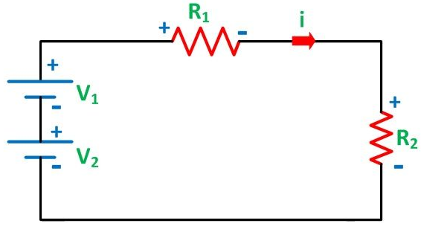
Kirchhoff’ Voltage Law
It states that the algebraic sum of the voltages (or voltage drops) in any closed path of a network that is transverse in a single direction is zero. In other words, in a closed circuit, the algebraic sum of all the EMFs and the algebraic sum of all the voltage drops (product of current (I) and resistance (R) is zero.
Fig. 5 kvl
Σ E + Σ V = 0
https://circuitglobe.com/what-is-kirchhoffs-current-law-and-kirchhoffs-voltage-law.html

Slide 16
Kirchhoff’ Voltage Law
In any closed path (or circuit) in a network, the algebraic sum of the IR product is equal to the EMF in that path.
In other words, in any closed loop (which also known as Mesh), the algebraic sum of the EMF applied is equal to the algebraic sum of the voltage drops in the elements. Kirchhoff’s second law is also known as Voltage Law or Mesh law. ΣIR= ΣE.

Slide 17
Kirchhoff’ Voltage Law
From fig we can write the equation of circuit. We can consider that when we go from (-) polarity to (+) polarity we will take it as negative value or when we go from (+) polarity to (-) polarity we will take it as positive value.
It depends upon you solution will be same.
Fig.6 KVL circuit
https://circuitglobe.com/what-is-kirchhoffs-current-law-and-kirchhoffs-voltage-law.html

Slide 18

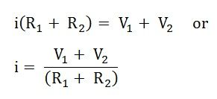
Kirchhoff’ Voltage Law
Here, the assumed current I causes a positive voltage drop when flowing from the positive to negative potential while negative potential drop when the current flowing from negative to the positive potential.

Slide 19
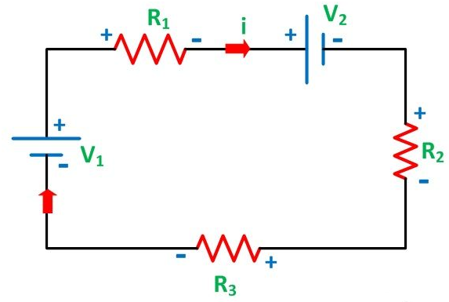
Kirchhoff’ Voltage Law
Considering the other figure shown below and assuming the direction of the current i.
Fig. 7 kvl circuit
https://circuitglobe.com/what-is-kirchhoffs-current-law-and-kirchhoffs-voltage-law.html

Slide 20
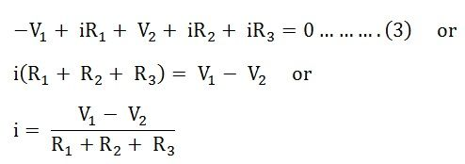
Kirchhoff’ Voltage Law
Therefore,
It is seen that the voltage V₁ is negative in both the equation (2) and equation (3) while V₂ is negative in the equation (2) but positive in the equation (3). This is because of the change in the direction of the current assumed in both the figures.

Slide 21
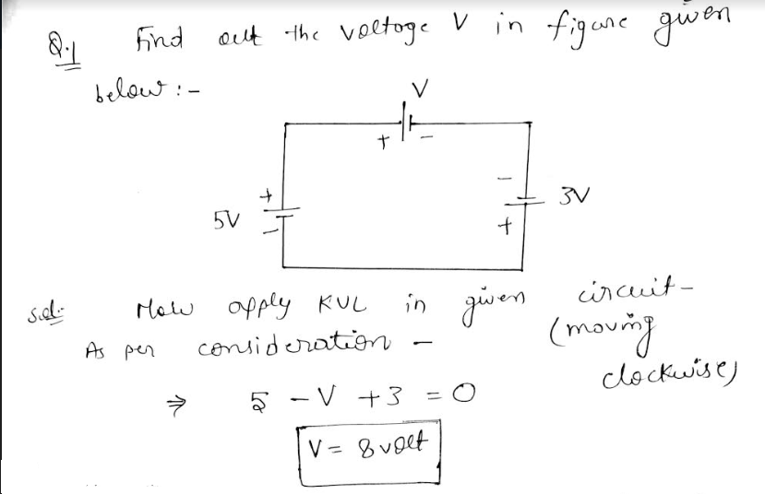
Numerical Based on Kirchhoff’ Voltage Law
Fig. 8 Numerical on KVL

Slide 22
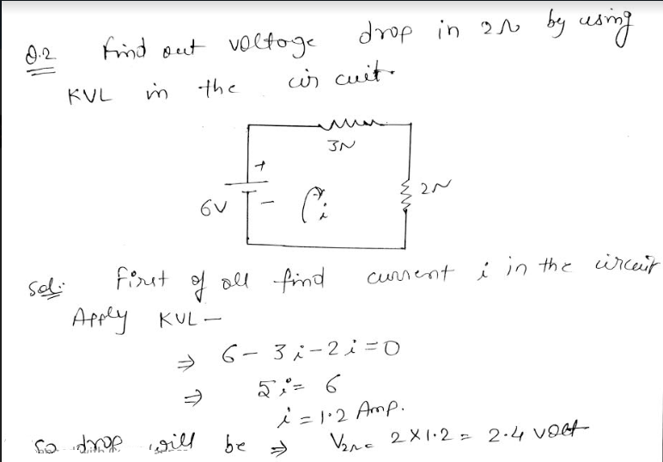
Numerical Based on Kirchhoff’ Voltage Law
Fig. 9 Numerical on KVL

Slide 23
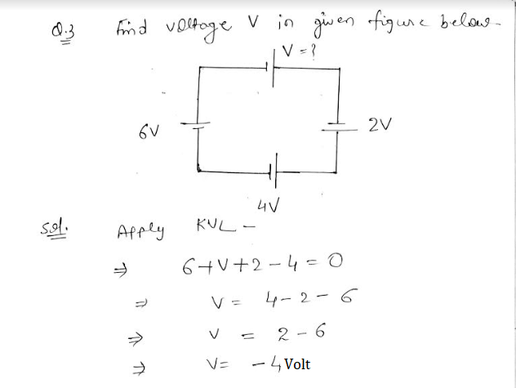
Numerical Based on Kirchhoff’ Voltage Law
Fig. 10 Numerical on KVL

Slide 24
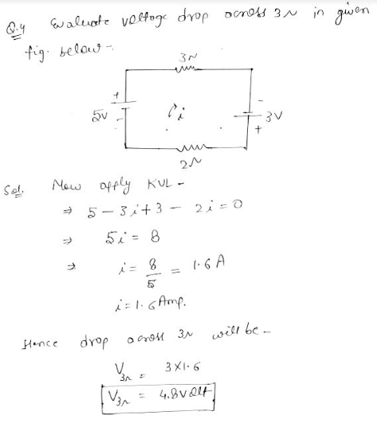
Numerical Based on Kirchhoff’ Voltage Law
Fig. 11 Numerical on KVL

Slide 25
Difference Between KVL and KCL
Parameter | KVL | KCL
Basis | Based on conservation of energy | Based on conservation of charge
Applicable | In closed path | At node
Definition | In closed circuit the algebraic sum of voltage drop is zero. | At any node the algebraic sum of currents is zero.
Assumption | Total number of closed loop paths | Total number of closed nodes
Table.1 Difference Between KVL & KCL

Slide 26
Applications of Kirchhoff’s Laws
Kirchhoff’s laws help to evaluate all voltage and current in any circuit.
These are used to overcome the problem of complexity of the circuit.
Kirchhoff's laws are used to help us in understanding how current and voltage work within a circuit?
These help to understand the amount of voltage or current present in the circuit.

Slide 27
Summary
We have discussed introduction to kirchhoff’s law.
We have studied about different terminologies used in kirchhoff’s law.
We have discussed examples based on kirchhoff’s laws.
Differentiation between KVL & KCL.
We have learnt applications of kirchhoff’s law.

Slide 28
Frequently Asked Questions
Give the statement of kirchhoff’s voltage law.
Give the statement of kirchhoff’s current law.
In which networks kirchhoff’s laws are applicable?
Give the difference between kvl and kcl.
Define node, loop and mesh in your own words.

Slide 29
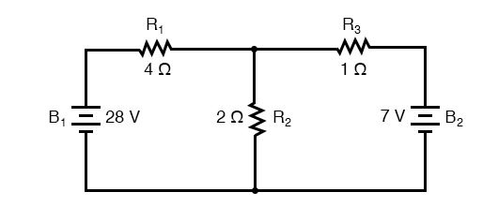
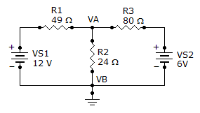
Practice Questions
Find out the current in 2ohm in a circuit.
Evaluate the current in 24ohm as given figure below.

Slide 30

LEARNING OUTCOMES
To make students understand
Concepts of kirchhoff’s laws with the help of examples.
Importance of kirchhoff’s lwas in electrical networks.
Fundamentals of kirchhoff’s laws with different terms used.

Slide 31
Course Outcome to Program Outcome Relationship
 |  | (21ELH-101) BEEE
PO→
CO↓ | PO1 | PO2 | PO3 | PO4 | PO5 | PO6 | PO7 | PO8 | PO9 | PO10 | PO11 | PO12 | PSO1 | PSO2 | PSO3
CO1 | 3 | 2 |  |  |  |  |  |  |  |  |  |  | 3
CO2 | 3 | 2 |  |  |  |  |  |  |  |  |  |  | 3
CO3 | 3 | 2 |  |  |  |  |  |  |  |  |  |  | 3
CO4 | 3 | 2 |  |  |  |  |  |  |  |  |  |  | 3
CO5 | 3 | 2 |  |  |  |  |  |  |  |  |  |  | 3

Slide 32
Assessment Pattern
A Assignment (each assignment) | B Time Bound Surprise Test (each test) | C Quiz (each quiz) | D Mid Semester Test(one per test) | E Homework | F Discussion Forums | G Attendance and engagement Score on BB
10 | 12 | 4 | 20 | NA | NA | 2

Slide 33
References
https://circuitglobe.com/what-is-kirchhoffs-current-law-and-kirchhoffs-voltage-law.html
https://study.com/academy/lesson/kirchhoffs-law-definition-application.html#:~:text=Kirchhoff's%20laws%20are%20used%20to,about%20series%20and%20parallel%20resistors.
https://www.student-circuit.com/learning/year2/electronic-circuits/kirchhoffs-law-application-circuits-analysis/
https://www.khanacademy.org/science/physics/circuits-topic/circuits-resistance/a/ee-kirchhoffs-laws

Slide 34
THANK YOU
For queries
Email: akhilnigam.eee@cumail.in

